Slide 1

Role of social partners in promoting sustainable development
„BIPARTISM AS A TOOL FOR SUCCESS“
Osijek, 12th February 2015
Natalia Stolz

Slide 2
What is the IOE ?
Peak international organisation representing employers organisations and their members.
  Private and voluntary.
  Not part of ILO - Not paid by ILO – Independent.
Most representative global business organisation : 150 EOs in 144 countries.
Established in 1920

Slide 3
Situating the IOE
EMPLOYERS UNIONS
GLOBAL IOE ITUC
OECD BIAC TUAC
EUROPE Businesseurope ETUC

Slide 4
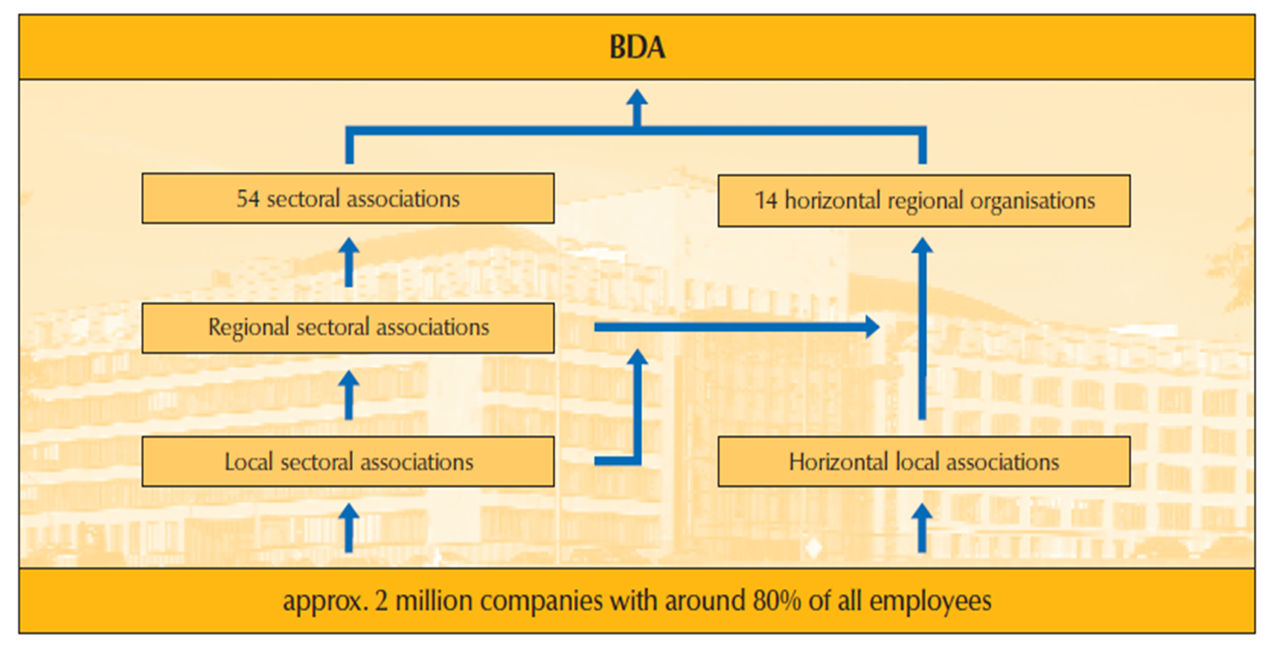

Slide 5
Bipartism - Social Dialogue without state influence
State
Trade Unions
Employer

Slide 6
Typical topics for collective bipartite bargaining
Wage and salary agreements (regulate the wage/ salary, incentive payments, bonus payments)
Framework agreements (general working conditions like working time, holiday, overtime hours)
Special collective agreements (for example agreements to protect workers against rationalisation)

Slide 7
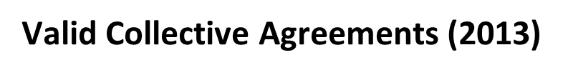
In Total: ~ 70,000 Collective Agreements
There are: ~ 30,000 collective agreements for branches
~ 39,000 company agreements (e.g. Volkswagen, Deutsche Lufthansa, Deutsche Telekom)

Slide 8
Success factors of Bipartite Social Dialogue
Employers or employer federations and trade unions are in a better position than anybody to assess the economic situation in their sector or in their business and to agree acceptable arrangements for both sides promotes social peace.
Bipartite Social Dialogue promotes good governance, because agreements negotiated independently by the social partners are much better implemented than regulations from central authorities, as the parties involved feel directly bound by what they themselves have agreed.
Bipartite Social Dialogue gives the economic system greater legitimacy, as it gives people the opportunity and the necessary structures to get involved in decision-making processes that directly affect them.

Slide 9
Enabling legislative frameworks for Bipartism
Legislation must provide room for employers’ and workers’ representatives to negotiate about terms and conditions of employment.
If legislation is too prescriptive, providing benefits and covering all eventualities, collective bargaining can not take place because there is nothing to negotiate.
Legislation must provide minimum floor below which no employer can go – not a “maximum” that all employers apply.

Slide 10
In many European countries bipartite Social Dialogue has addressed successfully the impact of the crisis
Social dialogue in the majority of European Member States resulted in the introduction of Short Time Working arrangements. This typically required the agreement of both social partners and even sometimes government support when subsidies were needed to top up workers’ lost income or fund training.
Sectoral collective agreements dealt with issues such as short-time agreements, restraints of salary increases as an alternative to dismissals, cost-cutting measures, and promoting training.

Slide 11
Collective Agreements in the last years
Moderate Agreements with:
Longer runtime (~ 24 months),
Lump-sum-payments,
Opening clauses in sectoral collective agreements (allow enterprises to negotiate working conditions at company level),
Moderate wage increase (and often several months without any pay increase),
Protection against dismissals.

Slide 12

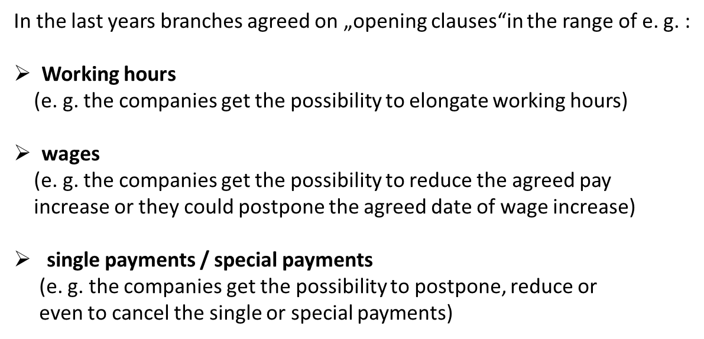

Slide 13
Development of agreed wages and acctual earnings
in %

Slide 14
Social partners are reaping the rewards of their responsibility during the crisis:
Lower unemployment: only modest increase in unemployment from 7.5% in 2008 to 7.8% in 2009 and afterwards a steady decline to 5.3% in 2013.
Salaries going up again: German chemical industry: 0% wage increase in 2010, 4.1% wage increase in 2011; German metal industry: 0% in 2010, 2.7% in 2011 and 4.3% in 2012.

Slide 15
Questions, Comments, Complaints?
Thank you!
Natalia Stolz
BDA | Bundesvereinigung der
Deutschen Arbeitgeberverbände
T +49 30 2033-1300
n.stolz@arbeitgeber.de
www.arbeitgeber.de

Slide 16
Appendix

Slide 18
